Slide 1

A Tour to Statistically Informed Interactive Maps
Researcher: Carina Zheng
Supervisor: Richard Penny
With Statistics NZ
2015/16
Notes:
Simple introduction
Time: 30 sec
Last updated on 17/2/16
At 4.25pm

Slide 2
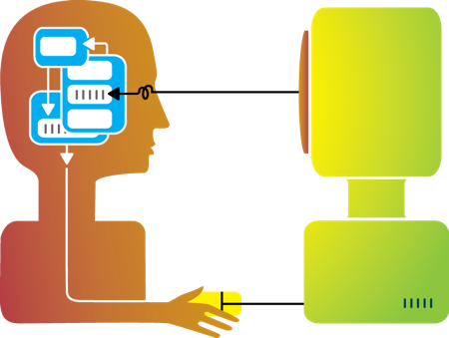
Motivation
Aim: To guide different types of users to view problems and results statistically.
Primary questions of interactive plots:
What are the good components?
Why are they good?
What are the bad components?
Why are they bad?
Project outline:
1. Get the feeling - See how others interactive plots look like,
how others users develop the plots,
what the feedbacks from users are like.
2. Experiment - Building our own app.
3. Draw our conclusion
Outline
Motivation
An Example
Background
Concept of the app
Reading Data
Preparation
Parameters
One-mean Table
One-mean Map
Two-mean Table
Scatterplot
Two-mean Map
A Little Taste
More to be done
The End
Notes:
Time: 2 min
There are many different types of interactive plots online. Therefore, We want to know how to make a user-friendly yet statistically accurate interactive plots which guide and encourage users to view the result in a statistical manner.

Slide 3
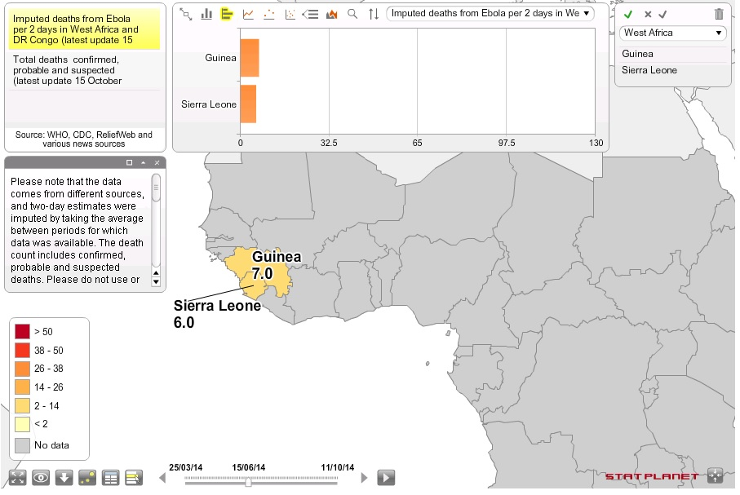
An example
Outline
Motivation
An Example
Background
Concept of the app
Reading Data
Preparation
Parameters
One-mean Table
One-mean Map
Two-mean Table
Scatterplot
Two-mean Map
A Little Taste
More to be done
The End
About this map, I think…
Good ☺
Many functions
Explanations and notes are available
Fancy looking
Bad ☹
Too much on one page
Top panel blocks part of the map
Now let’s start our project!
Map is retrieved from http://www.statsilk.com/maps/interactive-map-ebola-death-rate-west-africa-and-dr-congo-time-animation
Notes:
Design aspect:
Stat aspect: Graph above is showing the difference between two selections

Slide 4
Background
Outline
Motivation
An Example
Background
Concept of the app
Reading Data
Preparation
Parameters
One-mean Table
One-mean Map
Two-mean Table
Scatterplot
Two-mean Map
A Little Taste
More to be done
The End
Source Data: From Statistics New Zealand, titled “Main means of travel to work, for the employed census usually resident population count aged 15 years and over, 2001, 2006, and 2013 Censuses (RC, TA, AU)”
-- data of year 2013 in Territory Authorities (TA) is being used here
Spatial files: ESRI shapefiles named “New Zealand 2013 (NZTM)”, in Census-based files section.
in Territory Authorities (TA)
Operating System: Windows
RStudio, version 0.99.489
R library: 3.2
Notes:
Time: 0.5 - 1 min
Brief explanation
Why we use TA, 2013

Slide 5
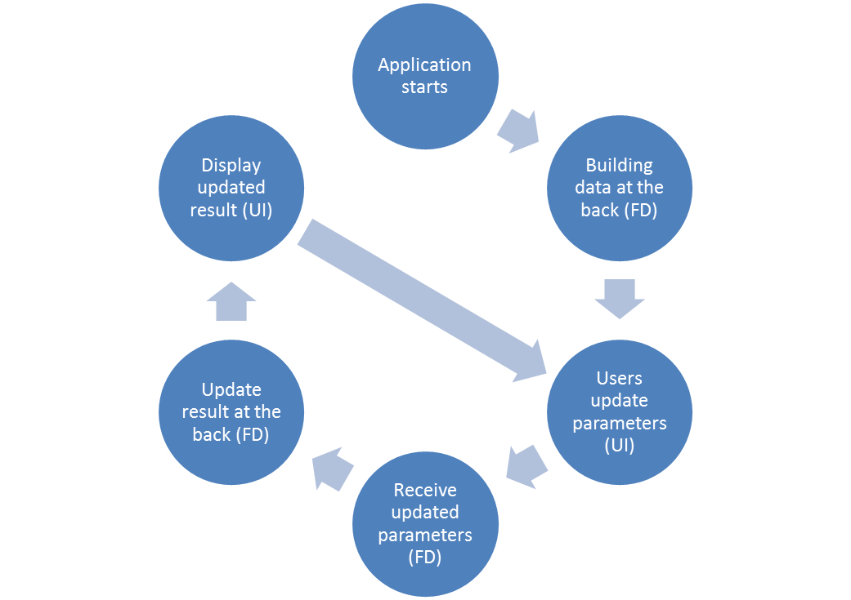
Concept of the app
Outline
Motivation
An Example
Background
Concept of the app
Reading Data
Preparation
Parameters
One-mean Table
One-mean Map
Two-mean Table
Scatterplot
Two-mean Map
A Little Taste
More to be done
The End
Notes:
Time: 1min
Explanation to processes
We are building a bridge between users and the computers here.

Slide 6
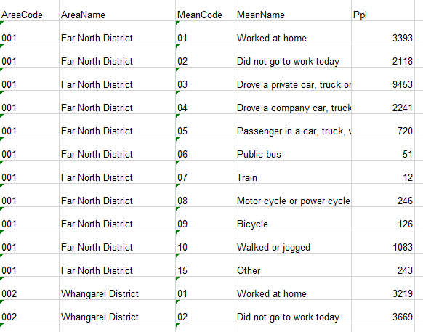
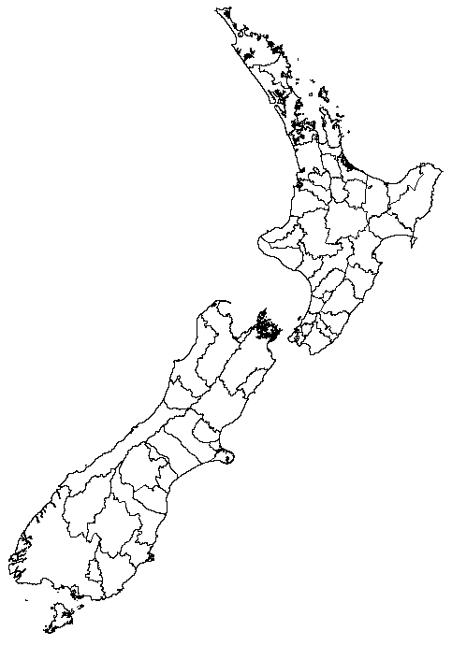
Reading data
Outline
Motivation
An Example
Background
Concept of the app
Reading Data
Preparation
Parameters
One-mean Table
One-mean Map
Two-mean Table
Scatterplot
Two-mean Map
A Little Taste
More to be done
The End
Reading the source data from csv file.
Generating objects from the source data.
Reading the shapefiles into R. (maptools)
Merging the source data to shapefiles object.
Notes:
Time: 2min
In csv format for more stable data storing
List objects are used for latter
maptools
no colours so no comparison can be made
manipulate the data by using the data attribute of the shapefiles object

Slide 7
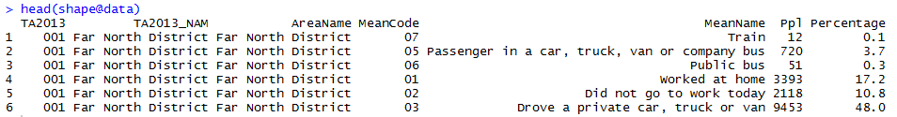
preparation
Outline
Motivation
An Example
Background
Concept of the app
Reading Data
Preparation
Parameters
One-mean Table
One-mean Map
Two-mean Table
Scatterplot
Two-mean Map
A Little Taste
More to be done
The End
Key method:
Calculating Percentages of travel means within territory authorities
Each percentage represents weight of a travel mean being chosen in a territory authority.
The numbers of people used specific travel means / total numbers of people in territory authorities
For example, there are 19,686 people from “Far North District" (a territory authority) involved in the research. 51 people chose "Public bus" (a travel mean) on the survey conducted day. Therefore, the percentage of "Public bus" in " Far North District" is calculated as
51/ 19,686 = 0.3 (1 decimal place)
Notes:
Time: 1.5min
We remain one decimal place in this research because having more decimal places would have the same effect yet it does not have a better reading.
calculation explanation:
the pie chart is sum to 100%
each travel mean has a percentage
11 travel means in total
ppl used specific means / total ppl

Slide 8
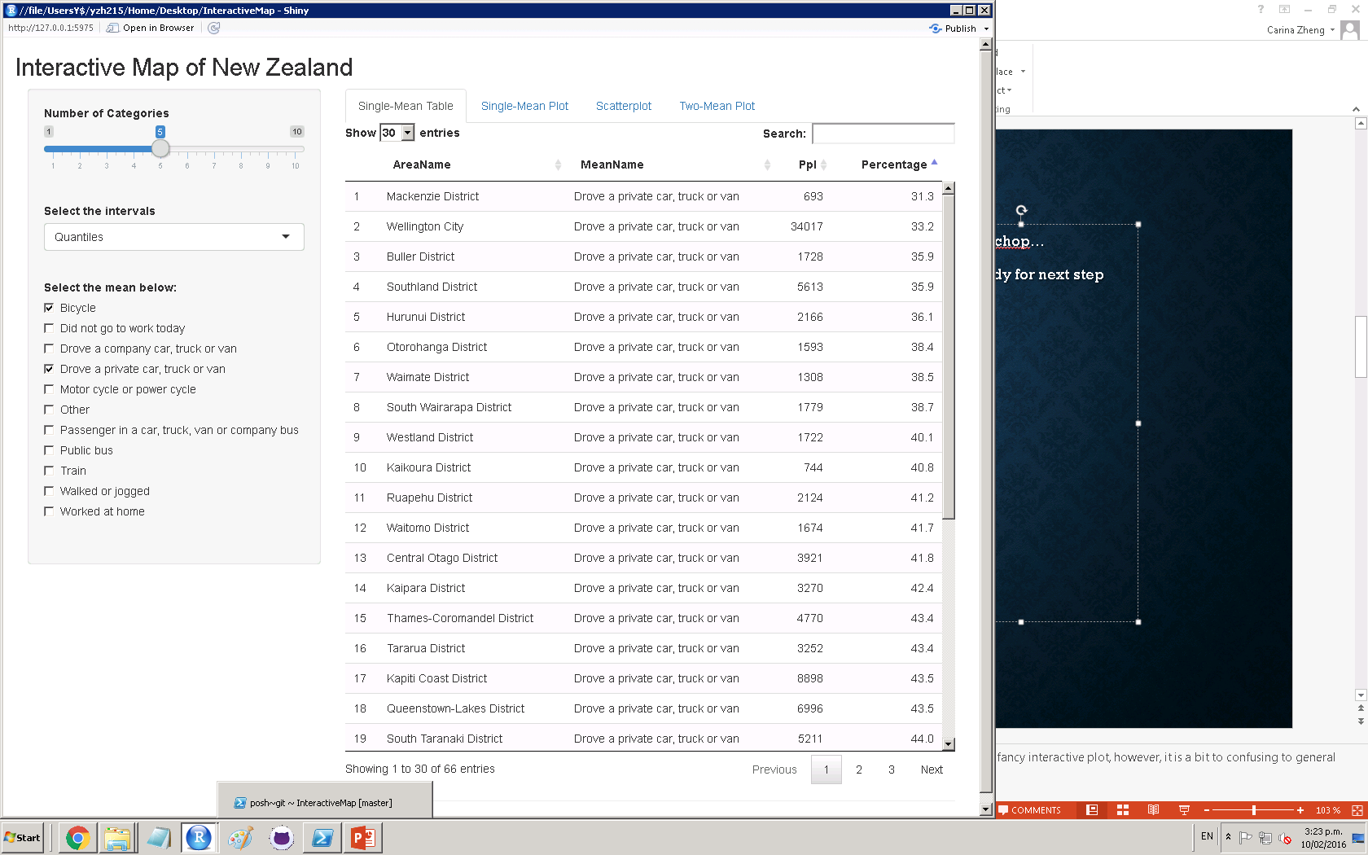
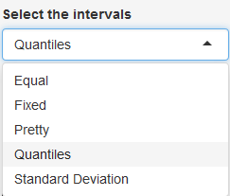
Parameters
Select the number of categories which is used for:
Separating the full data.
Assigning color to each value.
Outline
Motivation
An Example
Background
Concept of the app
Reading Data
Preparation
Parameters
One-mean Table
One-mean Map
Two-mean Table
Scatterplot
Two-mean Map
A Little Taste
More to be done
The End
Select the interval which is used for:
Separating the full data.
Assigning color to each value.
Select one travel mean to view, OR
Select two travel means to compare.
Notes:
Time: 2min
Categories: limit the arrange of the numbers quietly and politely
Intervals: Quantiles & SD are the only ones that could be more statistical (confusing to some users)
Pros and cons of these intervals
Means: only 11 means, enough space to be contained

Slide 9
One-mean table
Outline
Motivation
An Example
Background
Concept of the app
Reading Data
Preparation
Parameters
One-mean Table
One-mean Map
Two-mean Table
Scatterplot
Two-mean Map
A Little Taste
More to be done
The End
Selecting the subset of the source dataset. Such subset is using the same travel mean as the user last selected mean (in “mean selection” on the left hand panel).
Mainly using Shiny package for User Interface building.
Table is updated and rendered once the mean is changed.
Notes:
Time: 1.5min
STAT:
Comparing the difference by visual (looking at the numbers)
Not much visualization can be made – this tab is only for users who want to go into details and compare the numbers
Tech:
Key concept is using the corresponding subset of the data
Shiny helps a lot
Table is refreshed automatically when mean is updated

Slide 10
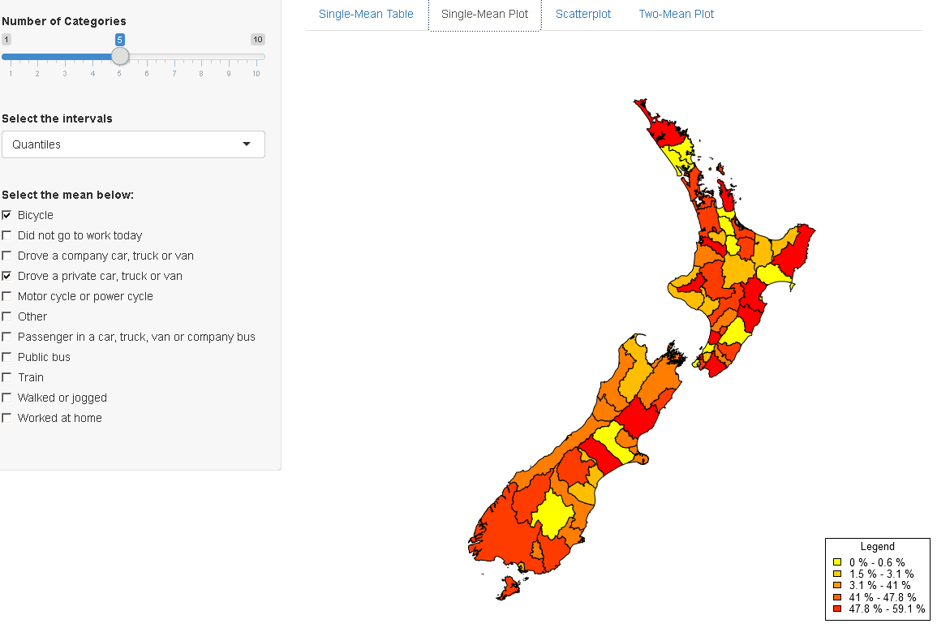
One-mean map
Key functions:
colorRampPalette – generating required series of colors. Supplying n, it returns n progressive colors.
classIntervals – separate data into n sets by selected style and their values.
findColours – match each value in dataset to a color
Customized legend –
“%” after numbers
Beginnings of intervals are added
“-” are added
Outline
Motivation
An Example
Background
Concept of the app
Reading Data
Preparation
Parameters
One-mean Table
One-mean Map
Two-mean Table
Scatterplot
Two-mean Map
A Little Taste
More to be done
The End
Notes:
Time: 2min
Tech:
Assigning colours to TA by the percentages of specific mean
Plot the map in TA with assigned colours
Legend
interval
Stat:
Compare to the initial map in slide 6, it’s easier to identify the difference of TA by colours (visualization)
Correlation is only valid in terms of physical locations

Slide 11
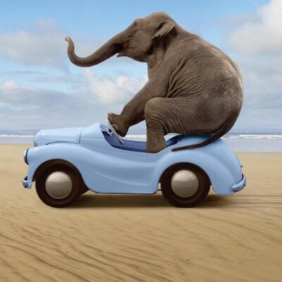
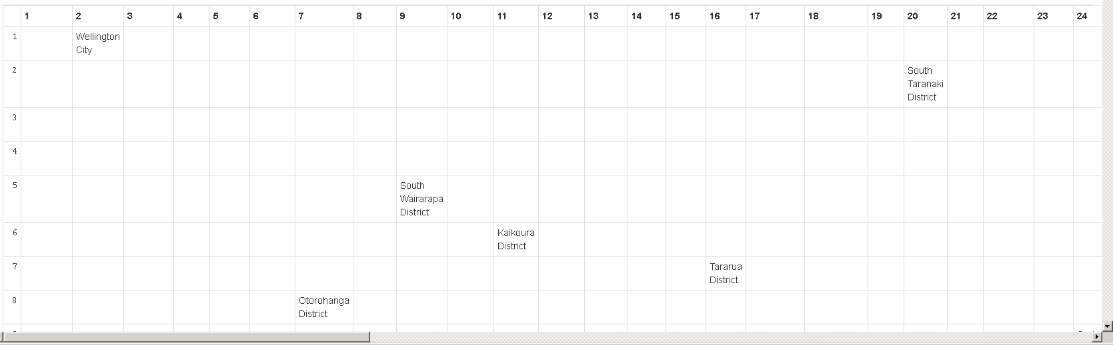
Two-mean table
Outline
Motivation
An Example
Background
Concept of the app
Reading Data
Preparation
Parameters
One-mean Table
One-mean Map
Two-mean Table
Scatterplot
Two-mean Map
A Little Taste
More to be done
The End
Eh… perhaps too much to squeeze in?
Notes:
Time: 1.5min
STAT:
Initial concept is using the matrix to contain the data (TA names as values, x and y positions are the ranks). Users would be able to see if the TA tend to use one mean more than another.
However, given the number of the TA in this project (67), they can’t fit in one page and scrolling is required. Cons is users don’t have so much patience (cuz even myself didn’t read the table in details). So idea was abandoned.
TECH:
Rank the percentages in each mean in ascending order
The positions of means would determine the TA positions in matrix

Slide 12
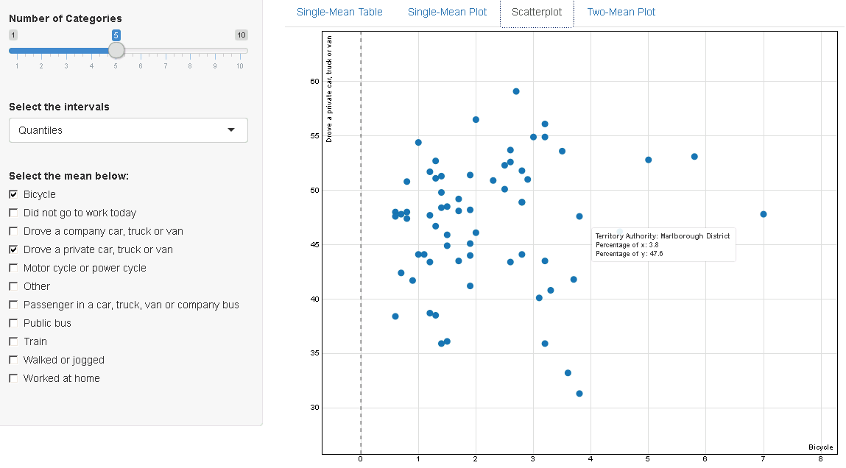
Scatterplot
Rank the territory authorities by percentages in separate travel means. The ranks are the x and y positions of the data points.
Supply the dataset to key function scatterD3. It draws the interactive scatterplot.
Outline
Motivation
An Example
Background
Concept of the app
Reading Data
Preparation
Parameters
One-mean Table
One-mean Map
Two-mean Table
Scatterplot
Two-mean Map
A Little Taste
More to be done
The End
Notes:
Time: 1.5min
Stat:
Scatterplot Pros: correlations between travel means in the same TA
Cons:
Not showing possible variable that affects the correlation
Tech:
scatterD3

Slide 13
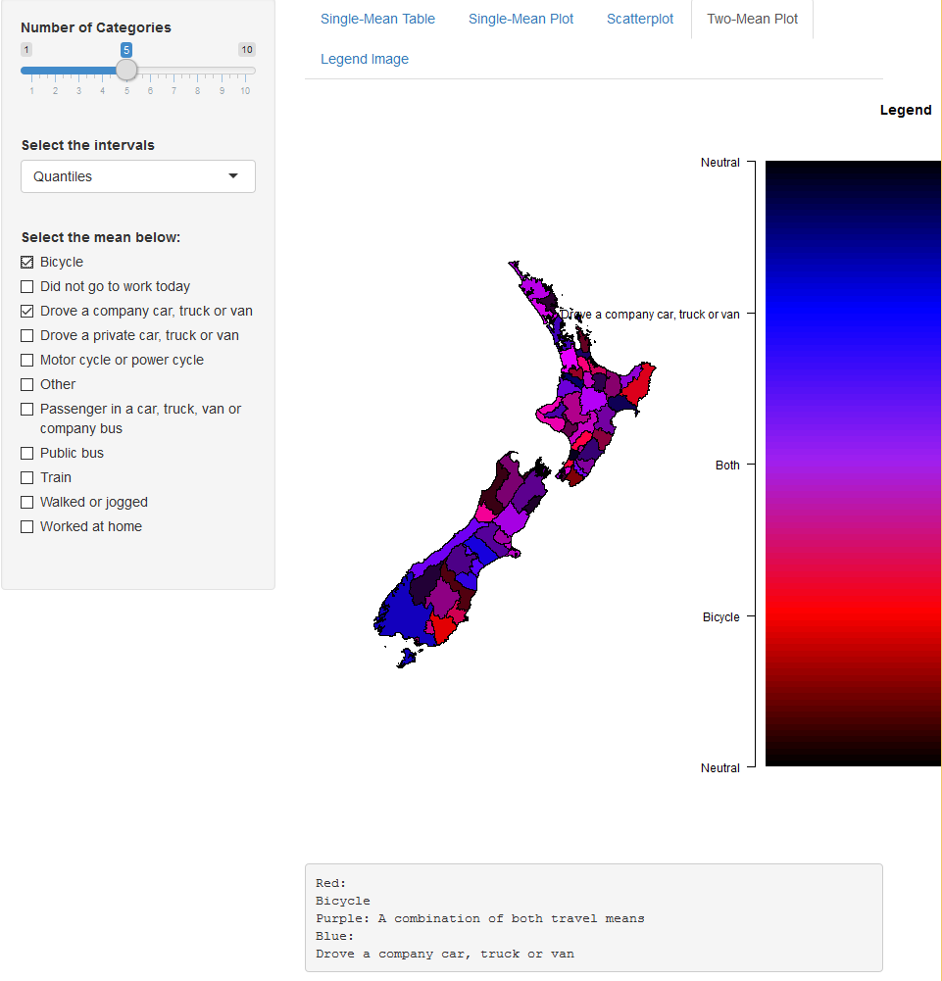
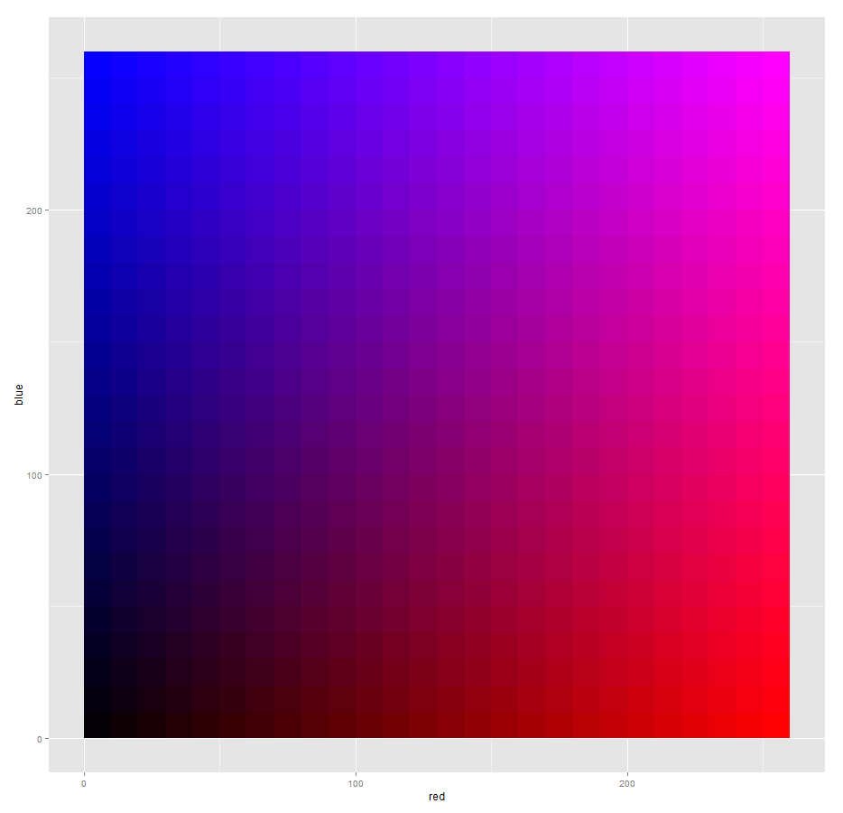

Two-mean map
Calculate the colors by their percentages in both means.
Progressive colors changing from blue (first selected travel mean) to red (second selected travel mean).
Legend is customized to distinguish the colors.
Outline
Motivation
An Example
Background
Concept of the app
Reading Data
Preparation
Parameters
One-mean Table
One-mean Map
Two-mean Table
Scatterplot
Two-mean Map
A Little Taste
More to be done
The End
Notes:
Time: 3min
STAT:
Show correlation in physical locations by colours
Two-mean
No details displayed
Tech:
Calculating and Computing of the colours
Comparing Two legends and the difficulties of outputting them
Have got the good one, but no time for it

Slide 14
A little taste
Outline
Motivation
An Example
Background
Concept of the app
Reading Data
Preparation
Parameters
One-mean Table
One-mean Map
Two-mean Table
Scatterplot
Two-mean Map
A Little Taste
More to be done
The End
Notes:
Time: 2min
Show the app

Slide 15

More to be done
Outline
Motivation
An Example
Background
Concept of the app
Reading Data
Preparation
Parameters
One-mean Table
One-mean Map
Two-mean Table
Scatterplot
Two-mean Map
A Little Taste
More to be done
The End
Better style
Correlation analysis
Interactive linear regression
More statistical analysis
……
Notes:
Time: 3min
Correlation analysis – putting the scatterplot and map together. Highlight the corresponding TA in map when the data points are selected (multiple selection is available) in scatterplot.
This can enable users to find out if the correlation only exists in some TA which are around each other, or the TA are separated.
Interactive linear – this would have more parameters for users to use. enables

Slide 16
Hope you enjoyed it and thank you for your time!
Special thanks to Richard Penny (Supervisor)
UC staff
Statistics NZ
for the professional advices, help and the opportunity!
Outline
Motivation
An Example
Background
Concept of the app
Reading Data
Preparation
Parameters
One-mean Table
One-mean Map
Two-mean Table
Scatterplot
Two-mean Map
A Little Taste
More to be done
The End
Notes:
Time: 1min
TO DO:
1. Slide 13, update two-mean map legend

